Slide 1
Automation for SuperOffice

Slide 2
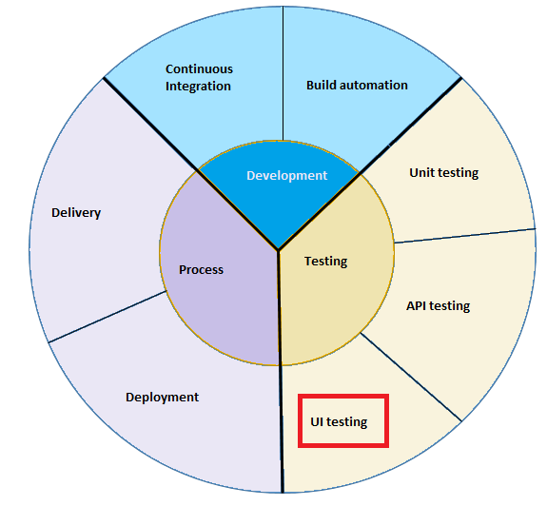
Automation in SDLC

Slide 3
Why test automation - benefits
Continuous delivery
Reduce manual test scope
Increase testing coverage
Increase testing speed
Improve overall quality
Give more time for exploratory testing
Not to replace QAs

Slide 4
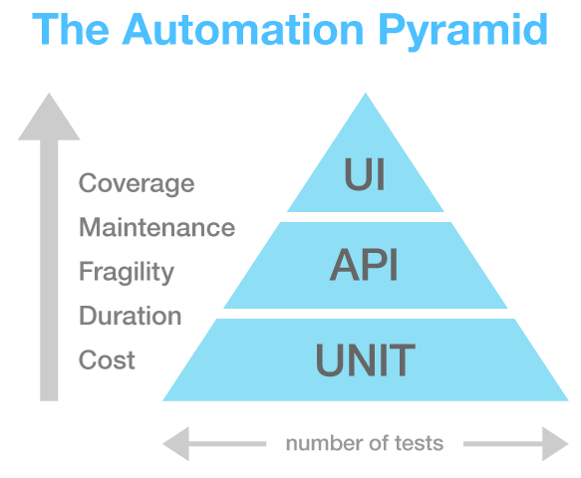

Slide 5
Criteria for selection of test cases for automaton:
Business value of test scenario
Manual test execution effort
Automation difficulty
What are good candidates
smoke test suite. Critical business scenarios with happy path
repetitive test scenarios
tests which need to run on multiple environments (Ex: Cross-browser testing)
Data-driven testing scenarios

Slide 6
Our Approach...
Identifying the most suitable automation tool
Challenge: The tool should support all the functions of SuperOffice product suite
POC for SuperOffice products
Select sample scenarios of SM web, SuperNet and CS applications
Controls Identification
Standard controls
Custom controls
3rd party controls
Handling Popups, Dialogs, Java scripts, Ajax
Scenario simulation
Validations

Slide 7
Scenarios and Controls
Customer Service |  | SM Web |  | SuperNet
Scenarios
Adding a New Customer |  | Adding a New Customer |  | New blog
New Request |  | Find |  | Search event
Search Request |  | New Sale |  | Manage forum
E Marketing Mailing Scenario |  | New Appointment |  | Mange article
Controls
HTML Controls |  | HTML controls |  | HTML controls
MDO Drop downs |  | MDO Drop downs |  | Light box
CKE Editor |  | IFrames |  | Masked Controls (for Date time)
Search result/ HTML tables |  | Date controls |  | Image controls
Image controls |  | Time controls

Slide 8


Tools

Slide 9
Issues Found in CodedUI
& Solutions from Telerik
Cross Browser Playback issues
We have run all the tests in IE, Chrome and Firefox browsers
Playback does not identify elements in different machines
This issue did not occur with Telerik
VS updates messes with the playback of tests
Tests are working for VS update 2
No frequent updates/ bug fixes/ improvements available
Since this is a commercial product Updates and bug fixes are available for the user
Image verification capabilities are not built in
Telerik has a built in Image verification module and we have tested it

Slide 10
Issues Found in CodedUI
& Solutions from Telerik
Object repo needs to be created manually (if not use "Test builder", which is time consuming.)
Object repository is created automatically and we can modify the repository using Telerik
Handling None Unique Elements
Test studio uses multiple methods to identify elements, not just a unique ID. Elements can be identified by
ID
Attributes
CSS Class
Xpath
Tagname

Slide 11
More Benefits…
Integration with MS visual studio
Integration with Team Foundation Server
Test studio is user friendly and easy to use for both Developers and QAs
No Extra classes or codes to be written for data driven testing
Customer support is available from the Telerik team

Slide 12
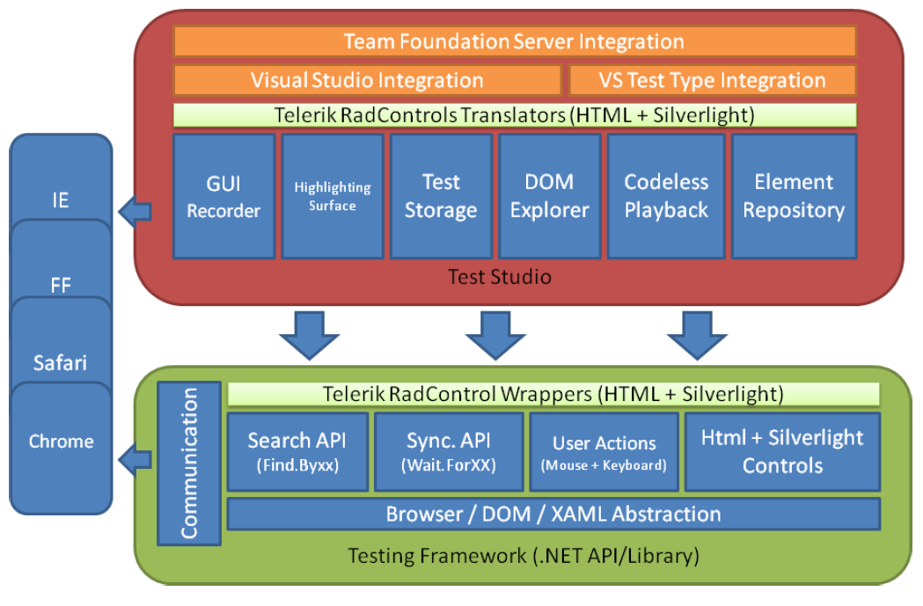
Telerik Test Studio Architecture

Slide 13
Telerik Test Framework
MTM
CI
Cross Bowser
API
Telerik Framework
Visual Studio
Ajax/JS
Version control
Dialogs

Slide 14
Contents of a Test Script
Code for simulating the scenario
Data Driven
Object repository
Test steps
Code for validation
(expected vs. actual)
Text validations
Image Validations
Database validations

